Slide 1
CFG: Normal forms
Dr G Sudha Sadasivam

Slide 2
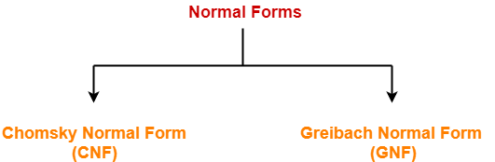
Introduction
Normalization is performed in order to standardize the grammar.
A → BC or A → a
where A, B, C are NT
a is a terminal.
Example:
S → AB
A → a; B → b

Slide 3
Eliminate epsilon Productions
S → ASA | aB
A → B | S
B → b | ε
Eliminate epsilon productions (B → ε and A→ ε)
S → ASA | aB | AS | SA | S | a
A → B | S
B → b

Slide 4
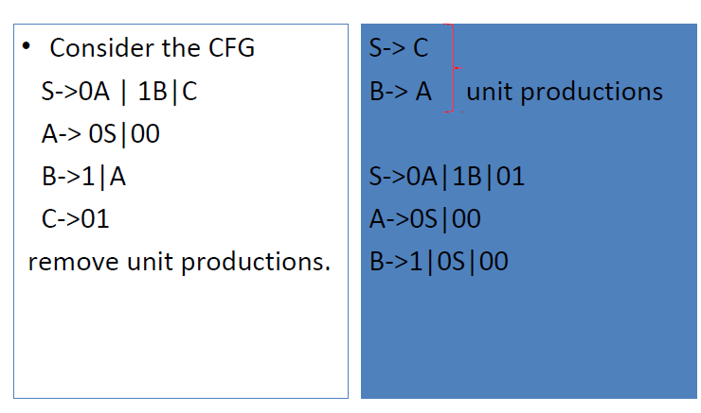
Eliminate unit Productions

Slide 5
Steps for CNF
Add a new start variable S0 → S if S is on the RHS
Reduce the grammar completely by-
Eliminating ∈ productions
Eliminating unit productions
Eliminating useless productions
Given, A → B₁B₂B₃….B_{n} where n > 2 with
A → B₁C where C → B₂B₃….B_{n,} . Repeat the steps
Replace each production of the form A → aB with A → XB and X → a.

Slide 6
An Example
S → aACa
A → B | a
B → C | c
C → cC | ε
1) Remove ε returns:
S → aACa | aAa | aCa | aa
A → B | a
B → C | c
C → cC | c

Slide 7
An Example
S → aACa | aAa | aCa | aa
A → B | a
B → C | c
C → cC | c
2) Next we apply remove Unit Productions:
Remove A → B. Add A → C | c.
Remove B → C. Add B → cC (B → c, already there).
Remove A → C. Add A → cC (A → c, already there).
So removeUnits returns:
S → aACa | aAa | aCa | aa
A → a | c | cC
B → c | cC
C → cC | c

Slide 8
An Example
S → aACa | aAa | aCa | aa
A → a | c | cC
B → c | cC
C → cC | c
3) Next we apply removeMixed, which returns:
S → T_{a}ACT_{a} | T_{a}AT_{a} | T_{a}CT_{a} | T_{a}T_{a}
A → a | c | T_{c}C
B → c | T_{c}C
C → T_{c}C | c
T_{a} → a
T_{c} → c

Slide 9
An Example
S → T_{a}ACT_{a} | T_{a}AT_{a} | T_{a}CT_{a} | T_{a}T_{a}
A → a | c | T_{c}C
B → c | T_{c}C
C → T_{c}C | c
T_{a} → a
T_{c} → c
Finally, we apply removeLong, which returns:
S → T_{a}S₁ S → T_{a}S₃ S → T_{a}S₄ S → T_{a}T_{a}
S₁ → AS₂ S₃ → AT_{a} S₄ → CT_{a}
S₂ → CT_{a} A → a | c | T_{c}C
B → c | T_{c}C
C → T_{c}C | c
T_{a} → a
T_{c} → c

Slide 10
GNF- Grebaich Normal Form

Slide 11
Greibach Normal Form
A context free grammar is said to be in Greibach Normal Form if all productions are in the following form:
A → αX
A is a non terminal symbols
α is a terminal symbol
X is a sequence of non terminal symbols.
It may be empty.

Slide 12
Greibach Normal Form
Example:
S → XA | BB
B → b | SB
X → b
A → a
S = A₁
X = A₂
A = A₃
B = A₄
A₁ → A₂A₃ | A₄A₄
A₄ → b | A₁A₄
A₂ → b
A₃ → a
CNF
New Labels
Updated CNF

Slide 13
Greibach Normal Form
Example:
A₁ → A₂A₃ | A₄A₄
A₄ → b | A₁A₄
A₂ → b
A₃ → a
First Step
A_{i} → A_{j}X_{k} j > i
X_{k} is a string of zero or more variables
A₄ → A₁A₄

Slide 14
Greibach Normal Form
Example:
First Step
A_{i} → A_{j}X_{k} j > i
A₄ → A₁A₄
A₁ → A₂A₃ | A₄A₄
A₄ → b | A₁A₄
A₂ → b
A₃ → a
| A₄A₄A₄
A₄ → A₂A₃A₄
| b
| A₄A₄A₄
A₄ → bA₃A₄
| b

Slide 15
Greibach Normal Form
Example:
A₁ → A₂A₃ | A₄A₄
A₄ → bA₃A₄ | A₄A₄A₄ | b
A₂ → b
A₃ → a
Second Step
Eliminate Left Recursions
A → A α | β
Can be written as
A → β A ‘
A ‘ → α A’ | ɛ
A₄ → A₄A₄A₄

Slide 16
Greibach Normal Form
Example:
Second Step
Eliminate Left Recursions
A₄ → bA₃A₄ | b
| bA₃A₄Z | bZ
A₁ → A₂A₃ | A₄A₄
A₄ → bA₃A₄ | A₄A₄A₄ | b
A₂ → b
A₃ → a
Z → A₄A₄
| A₄A₄Z

Slide 17
Eliminate left recursion
A → A α | β
Can be written as
A → β A’
A’ → α A’ | ɛ
example E → E + T | T
E → T E’
E’ → +TE’ | ɛ
eliminate ɛ
E → T E’ | T
E’→ +TE’ | +T

Slide 18
Greibach Normal Form
Example:
A₁ → A₂A₃ | A₄A₄
A₄ → bA₃A₄ | b | bA₃A₄Z | bZ
Z → A₄A₄ | A₄A₄ Z
A₂ → b
A₃ → a
A → αX
GNF

Slide 19
Greibach Normal Form
Example:
A₁ → A₂A₃ | A₄A₄
A₄ → bA₃A₄ | b | bA₃A₄Z | bZ
Z → A₄A₄ | A₄A₄ Z
A₂ → b
A₃ → a
A₁ → bA₃
| bA₃A₄A₄
| bA₄
| bA₃A₄ZA₄
| bZA₄
Z → bA₃A₄A₄ | bA₄ | bA₃A₄ZA₄ | bZA₄ | bA₃A₄A₄ | bA₄ | bA₃A₄ZA₄ | bZA₄

Slide 20
Greibach Normal Form
Example:
A₁ → bA₃ | bA₃A₄A₄ | bA₄ | bA₃A₄ZA₄ | bZA₄
A₄ → bA₃A₄ | b | bA₃A₄Z | bZ
Z → bA₃A₄A₄ | bA₄ | bA₃A₄ZA₄ | bZA₄ | bA₃A₄A₄ | bA₄ | bA₃A₄ZA₄ | bZA₄
A₂ → b
A₃ → a
Grammar in Greibach Normal Form

Slide 21
Home work
Convert to CNF and GNF formats
E→ E+T | T
T→ T*F | F
F→(E) | a

